Slide 1

Design Thinking 02
By
Debo Prasad Baruah

Slide 2


Emphasize becomes particularly difficult when you have to think for someone else, most people associate emphasize as emotional or physical trauma that somebody went through. The problem with such examples is we are not here to guide somebody or heal somebody. Neither we are doctors nor we are a psychologist.
We can emphasize with these situation but for this course we would take something simpler, something generic, something achievable and later when you become an expert in design thinking shall apply it for such problems.

Slide 3
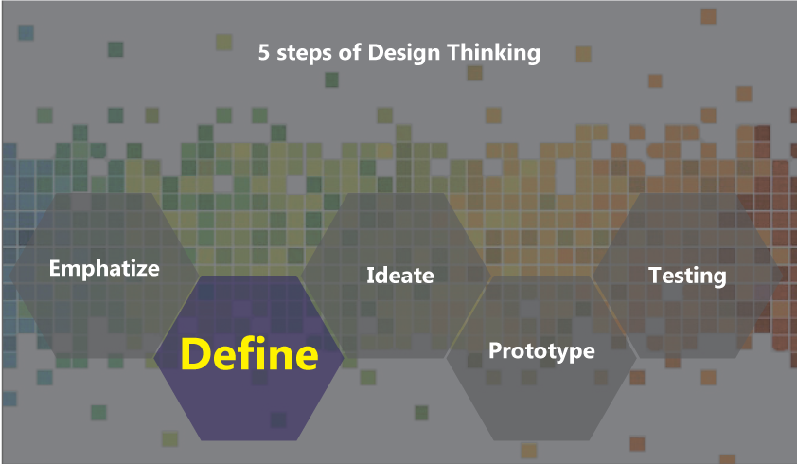
EMPHATIZE
PROBREM

Slide 4
DEFINE
EMPHATIZE
PROBLEM

Slide 5
Potential
of Intervention
Solvable
For Design Thinking we will take such cases which seems trivial but they are not, the occurrence is frequent and generic in nature, solvable problem within the realm of an organization or Individuals and there is a potential of intervention.
The above condition is however may vary from organization to organization, Target customer or Design Brief.
Design
Problem
Seems trivial
Generic
in nature
Frequently
occurring

Slide 6
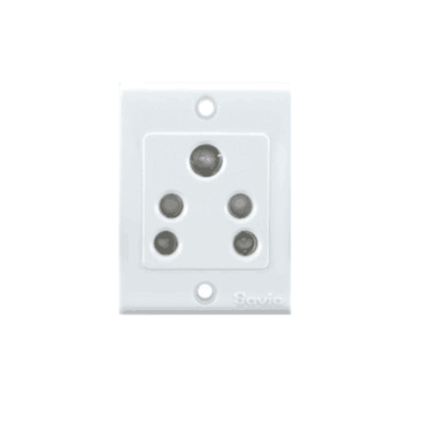
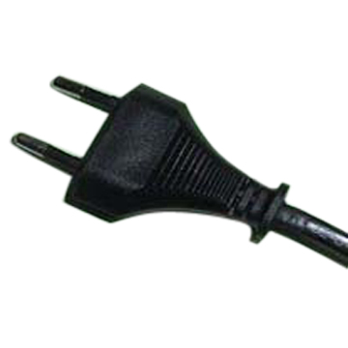
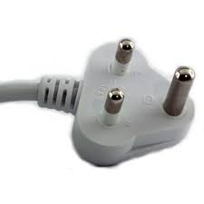
vs

Slide 7
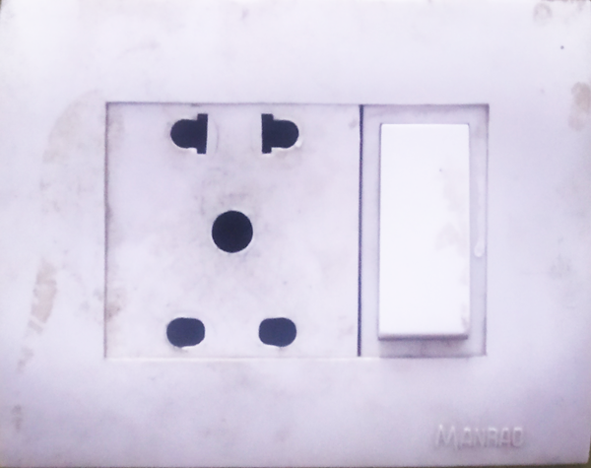
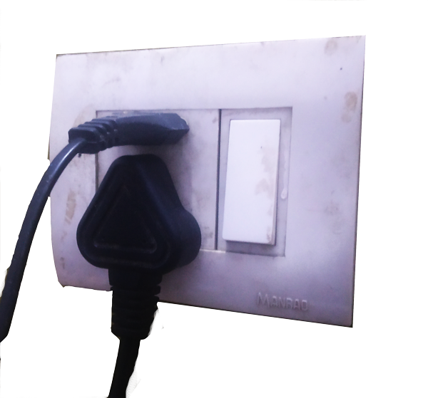
The solution may not be very complex.
The solution is rather simpler
The less intervention solution are best sometimes.

Slide 8

The cobra effect

Slide 9
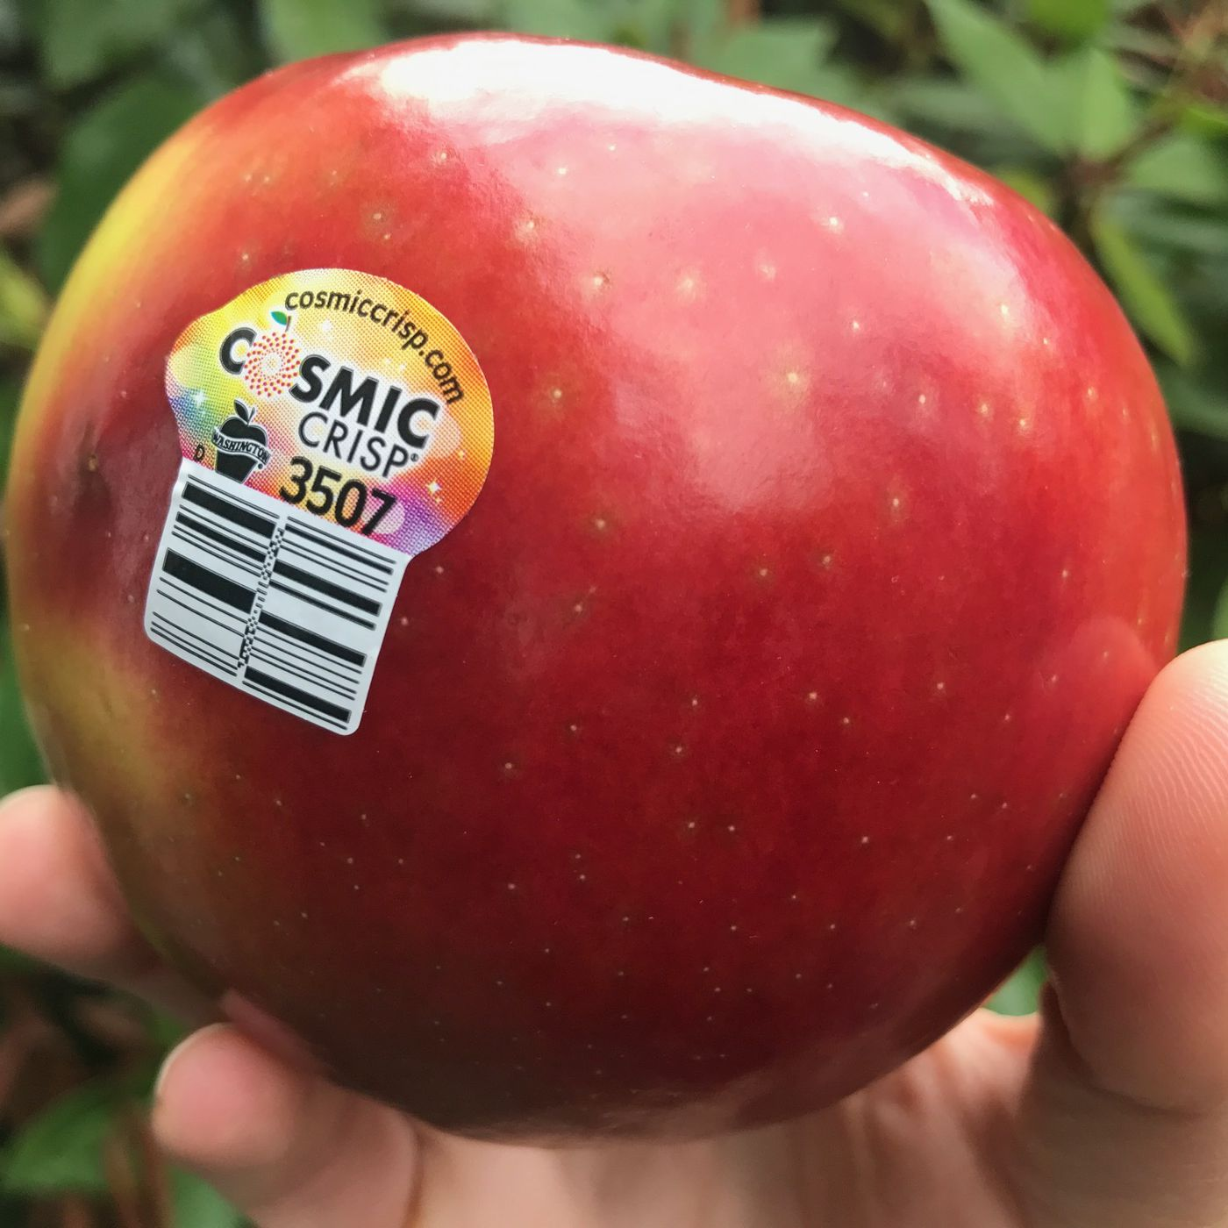
Apple Tag
It is a problem or a solution?

Slide 10

Observation

Slide 11

Listening

Slide 12


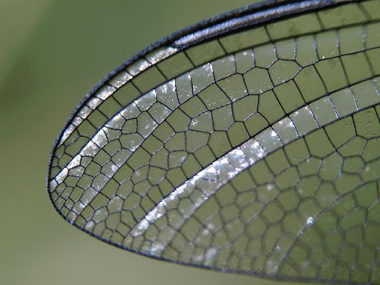

Going in D etails

Slide 13
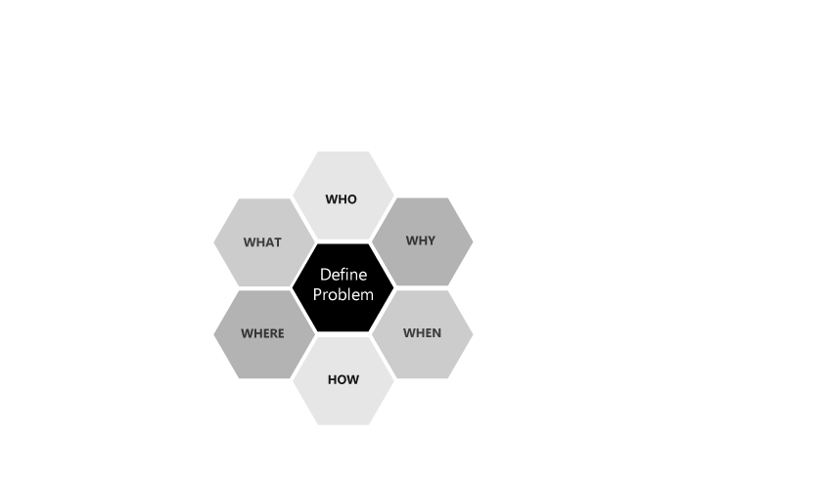

Slide 14
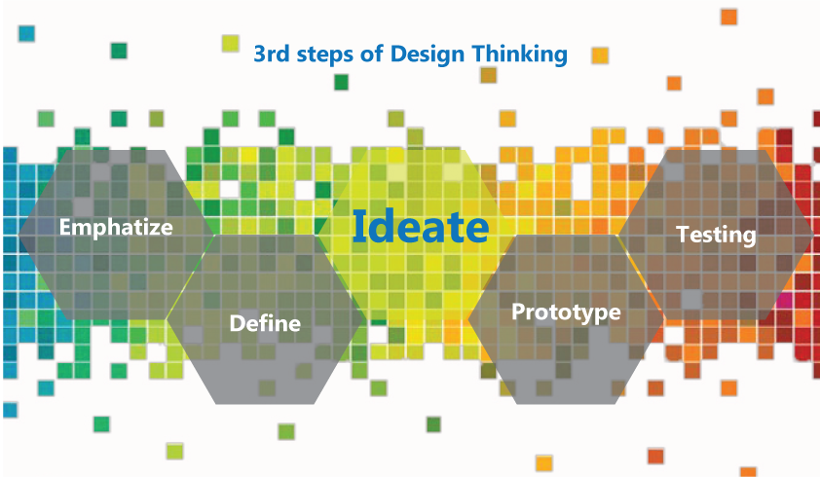

Slide 15
S
SUBSTITUTE
C
COMBINE
A
ADAPT/ADDITION
M
MODIFY/ MAGNIFY
P
PUT IN ANOTHER USE
E
ELIMINATE
R
REVERSE/REARRANGEMENT

Slide 16

Activity
Pick up one object(living/dead)
Use SCAMPER on it.
3. The outcome can be functional/ conceptual/ Imaginative/ hypothetical/ comedy/completely out of the BOX ( the choice is yours)

Slide 17

Lets Use SCAMPER on tyre

Slide 18
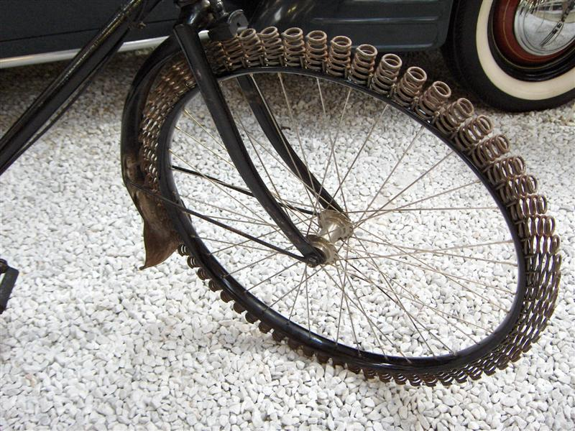
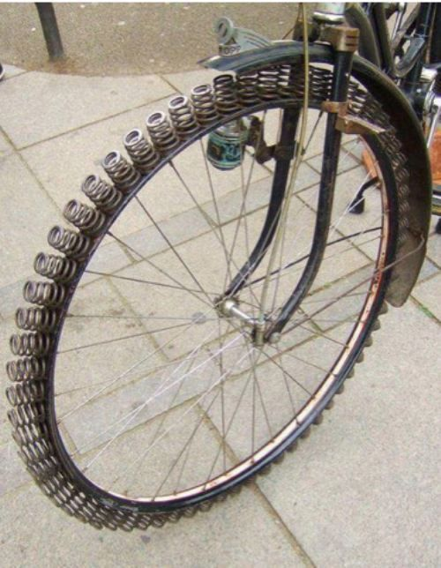
S
SUBSTITUTE

Slide 19

C
COMBINE

Slide 20
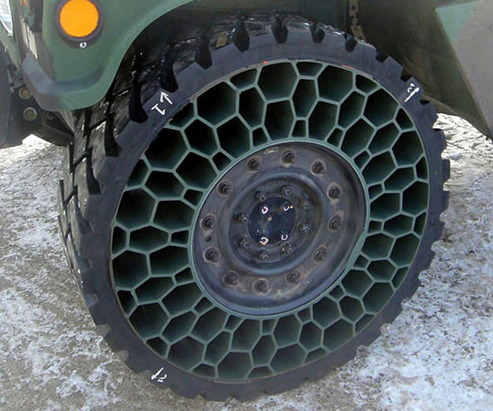
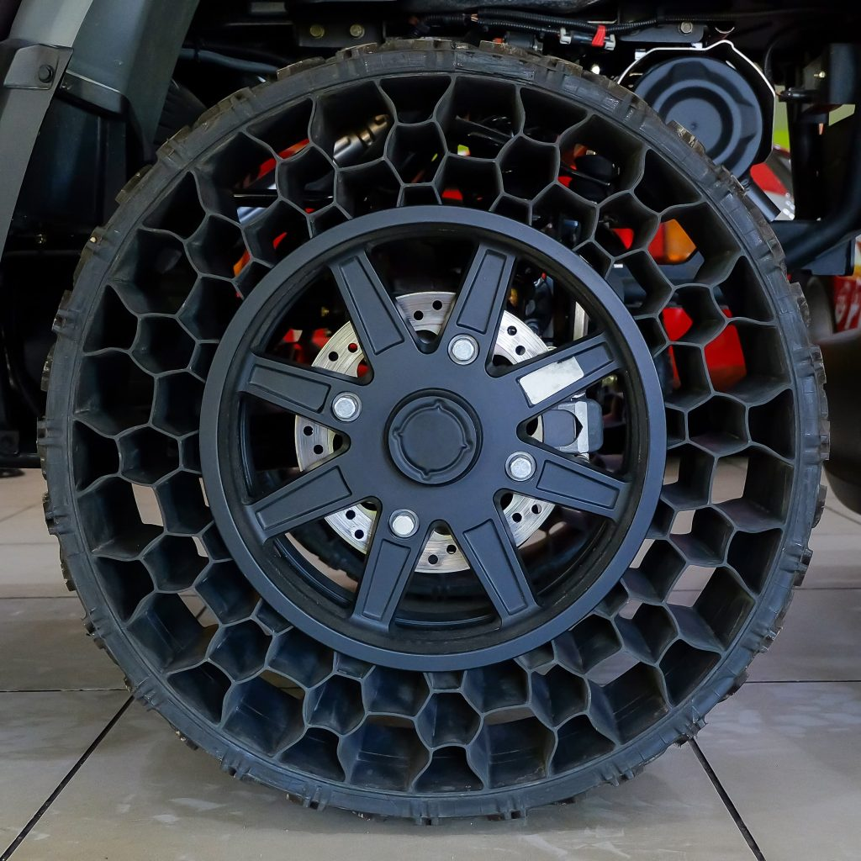
A
ADAPT/ADDITION
Michelin airless tyres

Slide 21
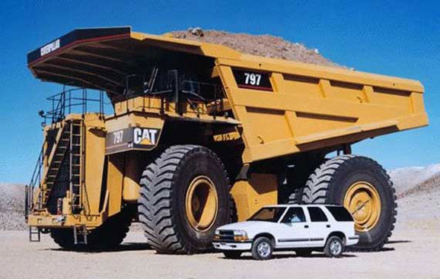
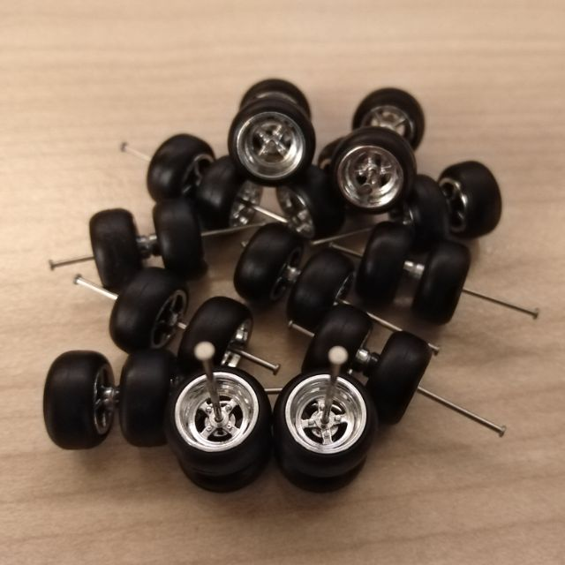
M
MODIFY/ MAGNIFY

Slide 22

P
PUT IN ANOTHER USE

Slide 23
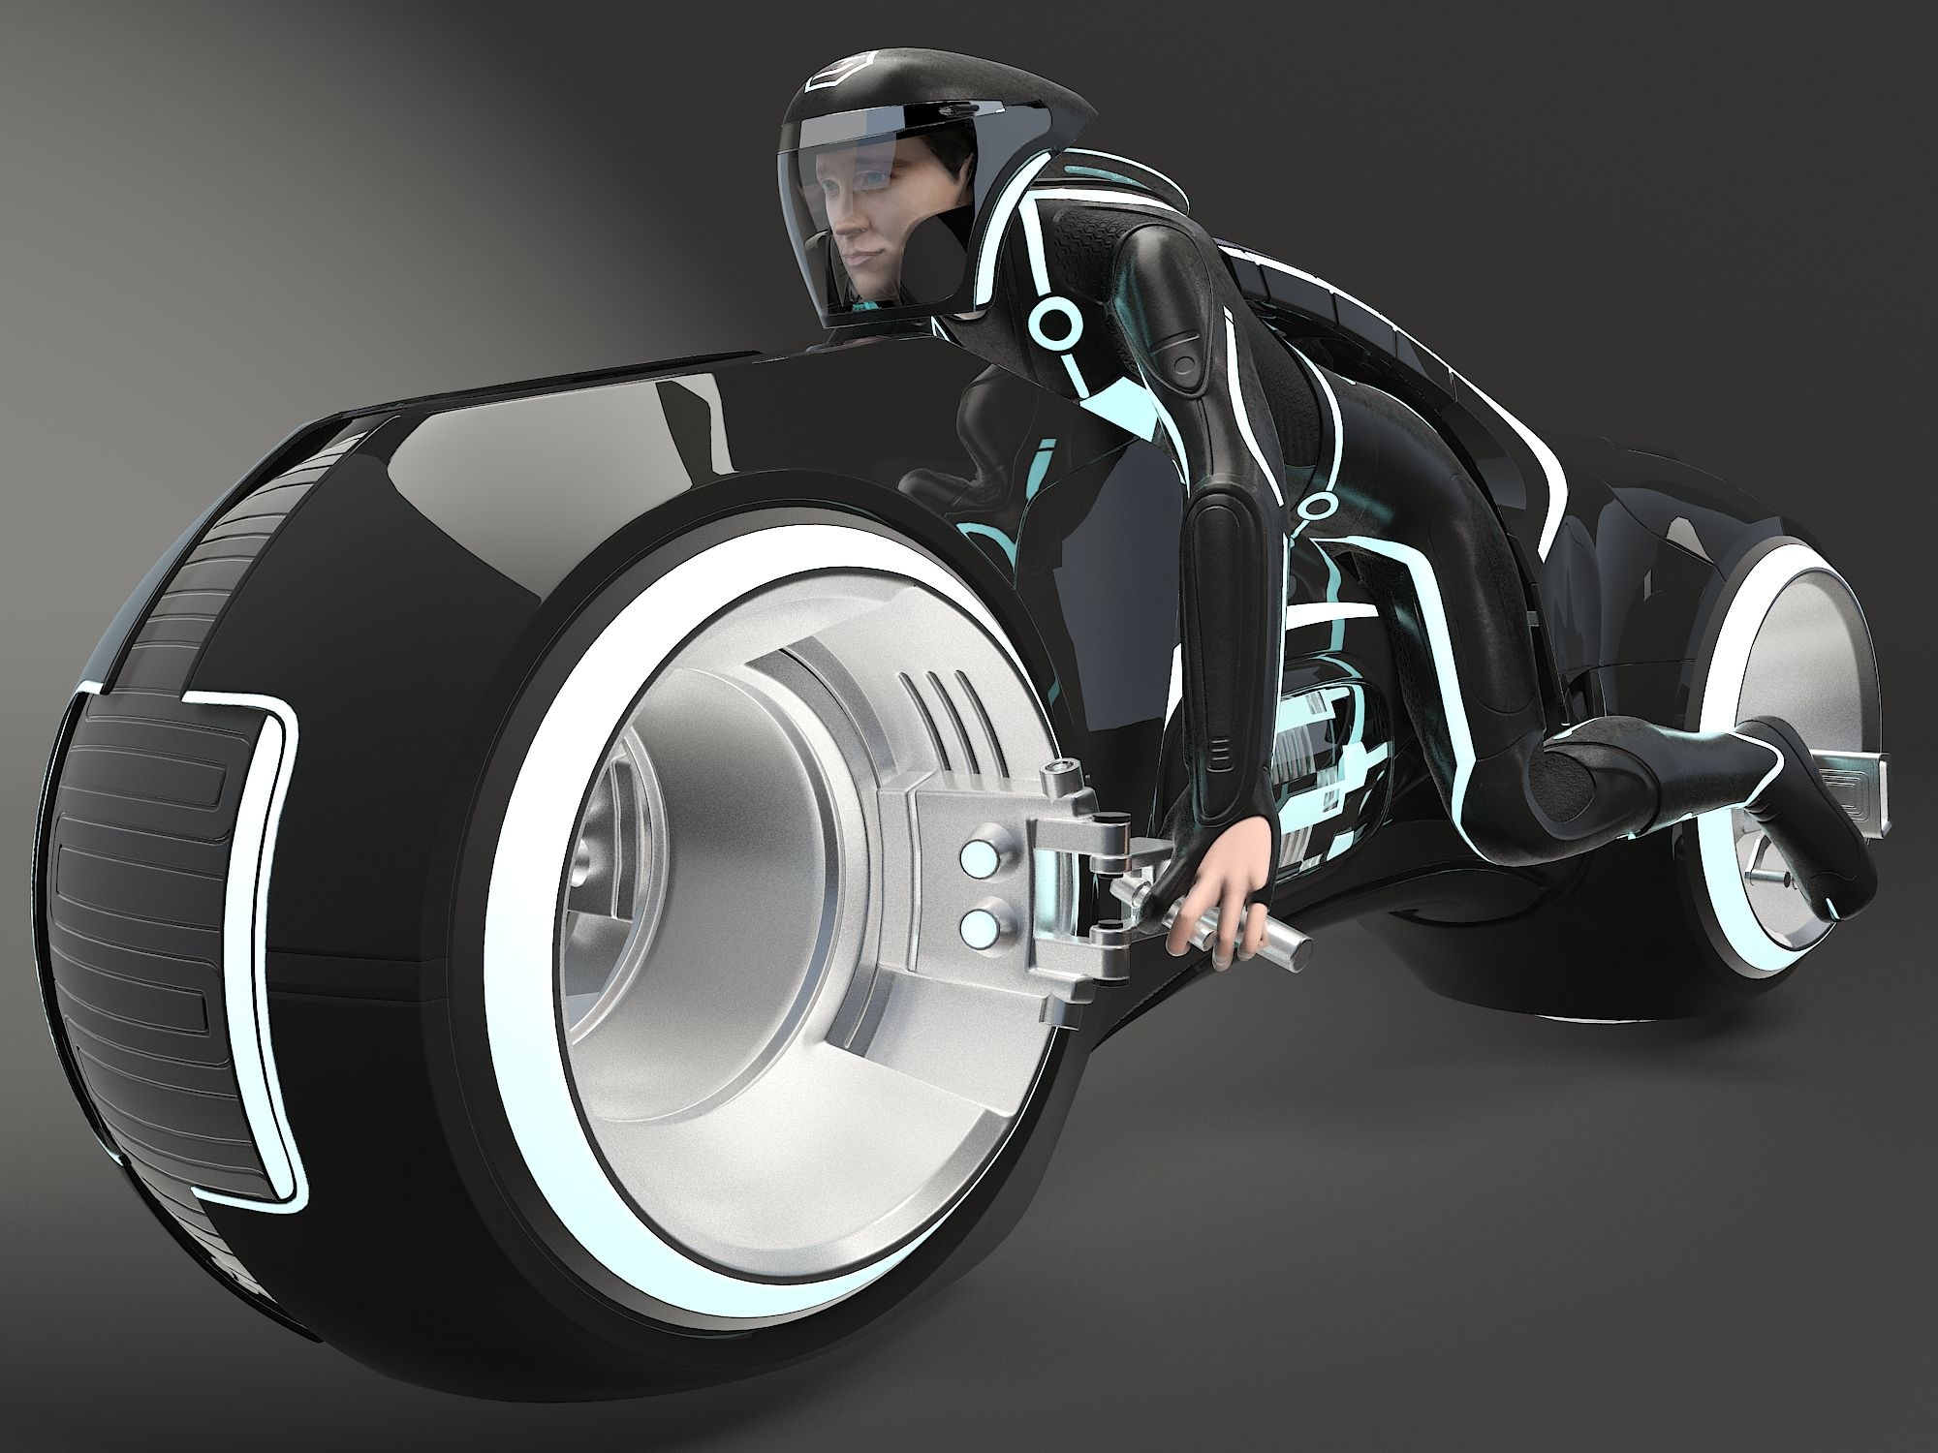
E
ELIMINATE

Slide 24
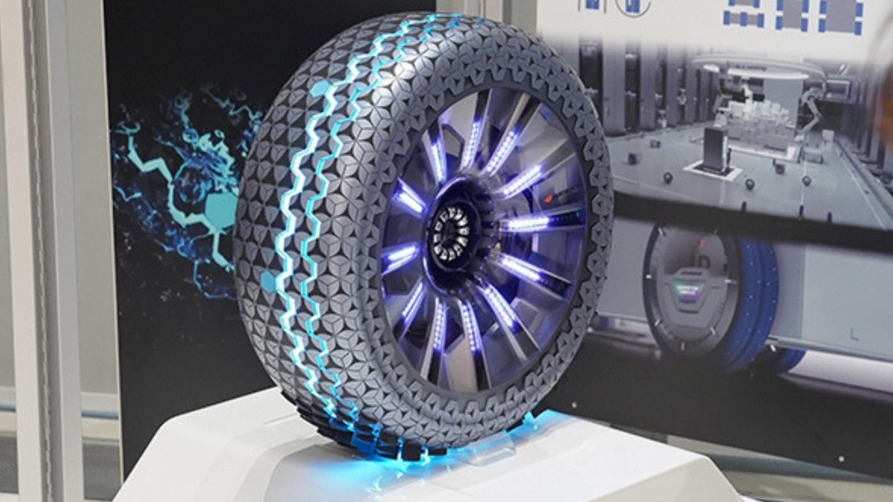
R
REVERSE/REARRANGEMENT
Concept tyre by Hankook

